Slide 1

A Presentation on Osteoarthritis Prediction Using Machine Learning
Ajeenkya DY Patil School of Engineering, Pune
Department of Artificial Intelligence & Data Science Engineering
AY: 2024-25 Class: SE SEM-IV
Guided by:
Prof. Ashwini Shinde
Presented by:SE_C_02
Roll no:23,24,55,66

Slide 2
Agenda
Introduction
Motivation
Problem Statement
Literature Survey
System Architecture/Algorithm
Conclusion
Future Scope
References

Slide 3
Introduction
What is Arthritis?
Arthritis is a broad term that refers to inflammation of the joints.
It affects millions of people worldwide, causing pain, stiffness, and reduced mobility.
Common types include Osteoarthritis (OA), Rheumatoid Arthritis (RA), and Psoriatic Arthritis.
Osteoarthritis (OA)
Is a degenerative joint disease affecting millions worldwide.
Characterized by cartilage degradation, leading to pain, stiffness, and reduced mobility.
Early detection is crucial for effective treatment and improved quality of life.

Slide 4
Motivation
Challenges with Traditional OA Diagnosis
Late-stage detection: OA is often diagnosed only when significant joint damage has occurred.
Time-consuming & expensive: MRI scans and other advanced diagnostics are not always accessible.
Therefore it is necessary to detect osteoarthritis at an early stage to prevent irreversible damages.
Early Intervention-Early prediction allows for prompt treatment. This reduces disease progression.
Improved Outcomes-Timely interventions improve patient quality of life.
Resource Allocation-Prediction helps allocate healthcare resources efficiently.

Slide 5
Problem Statement
Develop an AI-driven system using machine learning for early osteoarthritis prediction.
By combining medical imaging, clinical data, and predictive modelling, this approach enables timely interventions, personalized treatment plans, and better patient outcomes.

Slide 6
Literature Survey
SR. NO | NAME AND AUTHOR | YEAR | DESCRIPTION | CHALLENGES
1. | The application of machine learning in early diagnosis of osteoarthritis. Anran Xuan, Haowei Chen,Zhaohua Zhu | MARCH 2023 | This paper explores the growing role of machine learning in the early diagnosis of osteoarthritis, a leading musculoskeletal disease. Current diagnostic methods fail to detect OA in its early stages, but ML-based models combined with advanced imaging techniques offer promising solutions. This review discusses recent advancements, limitations, and future research directions for ML in OA prediction. | ML models require large datasets, but early-stage OA cases are often underrepresented in medical records. Current diagnostic methods detect OA only after significant joint damage, limiting early intervention.
2. | Knee Osteoarthritis Analysis Using Deep Learning and XAI on X-Rays. Rafique Ahmed, Ali Shariq Imran | MAY 2024 | This paper examines deep learning for knee osteoarthritis prediction using X-ray images. While CNN-based models automate diagnosis, their lack of interpretability reduces trust. Using explainable AI and a refined classification approach, this study tests five DL models on Kellgren-Lawrence graded images. EfficientNetb7 achieves 99.13% accuracy for normal vs. severe cases but drops to 67% for other classifications, highlighting its limitations. | Training deep learning models requires extensive, well-annotated X-ray image datasets, which are often limited. Integrating AI tools into real-world healthcare requires validation, regulatory approval, and clinician acceptance.
3. | Understanding the role of machine learning in predicting progression of osteoarthritis. Simone Castagno, Benjamin Gompels, Estelle Strangmark, Eve Robertson-Waters, Mark Birch, Mihaela van der Schaar, Andrew W McCaskie | NOV 2024 | This paper focuses on how machine learning can be used in the prediction osteoarthritis. As known osteoarthritis if detected late can cause irreversible damages. Therefore early detection may promise enhanced patient outcome. Machine learning offers the potential to analyse complex datasets, including medical imaging, clinical records, and genetic factors, to develop predictive models for osteoarthritis risk assessment. | The use of patient data in machine learning raises concerns about data security, patient consent, and bias in model predictions. Machine learning models require extensive datasets for training, but access to standardized, well-annotated medical data remains a challenge.
4. | Prediction Models for Knee Osteoarthritis: Review of Current Models and Future Directions. Taghi Ramazanian, Sunyang Fu, Sunghwan Sohn | 2023 | While various treatments provide symptomatic relief, there are currently no effective medical therapies to stop the progression of knee osteoarthritis. Early prediction of OA onset and progression is crucial for timely intervention, particularly by managing modifiable risk factors like obesity and joint malalignment. Prediction models, play a vital role in improving diagnosis, supporting clinical decision-making, and ultimately enhancing patient outcomes. | Many prediction models remain in research settings without widespread clinical adoption . ML models handle large datasets well but require extensive validation to ensure reliability and accuracy in real-world applications.

Slide 7
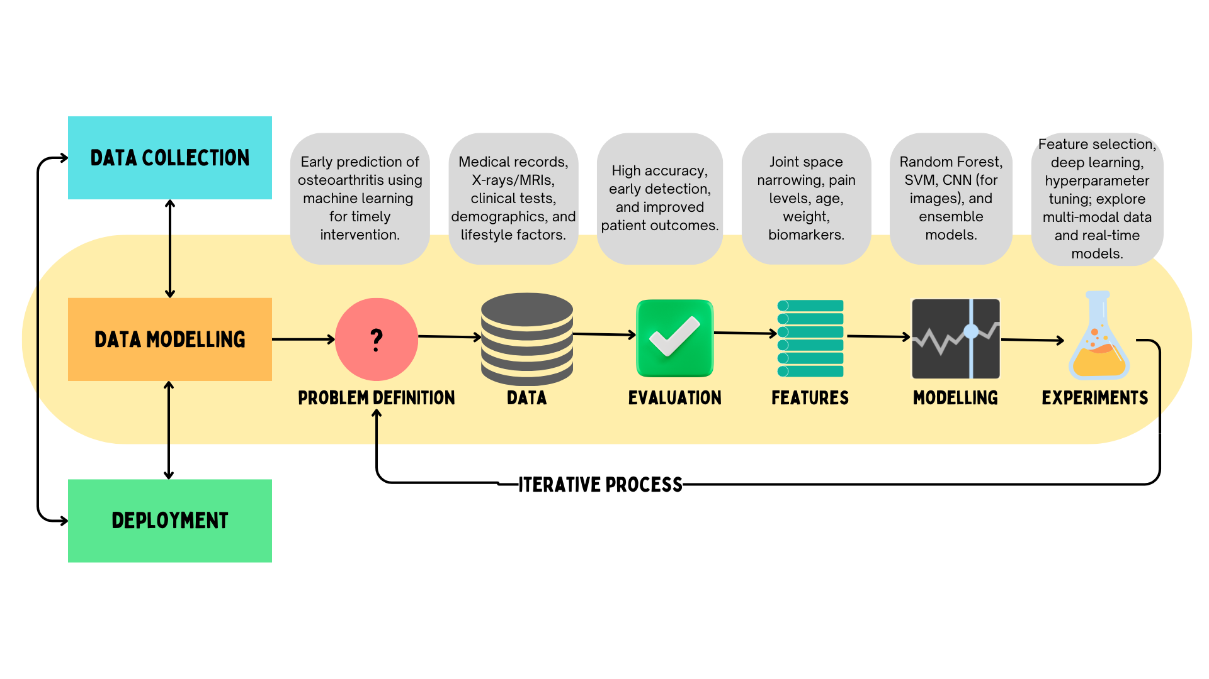
System Architecture

Slide 8
Implemention
The trained model was evaluated on a test set and its performance metrics were recorded.
The following are the results:
-Overall Loss: 1.8535
Currently, the model achieves an accuracy of 58.50%, which is expected to improve as it is trained on a larger and more diverse dataset. Expanding the dataset will enhance the model’s ability to recognize patterns, reduce overfitting, and improve generalization.
Additionally, fine-tuning hyperparameters, optimizing data augmentation techniques, and incorporating patient metadata could further boost performance, making the model more reliable for real-world clinical applications.

Slide 9
Conclusion
In a nutshell, AI integration in osteoarthritis detection enhances diagnostic accuracy, enables early detection, and improves patient care.
Advanced algorithms like CNN analyse medical imaging with high precision, paving the way for AI-driven personalized healthcare.
As technology evolves, machine learning promises to revolutionize OA diagnosis by improving speed and accuracy.

Slide 10
Future Scope
Advancements in ML for OA Prediction
Wearable Sensor Integration:
Real-time gait analysis using IoT and AI to detect early signs of OA.
Personalized Treatment Plans:
ML can help predict patient-specific treatment responses.
Federated Learning for Data Privacy:
Enables training on multiple hospital datasets without sharing sensitive data.
Explainable AI (XAI):
Ensuring model decisions are interpretable for clinicians.
Deployment in Healthcare Systems:
Integrating AI-assisted diagnosis into hospital workflows.

Slide 11
References
Sabat, S. K., Panda, S., Merli, P. K., & Bhuyan, S. K. (2022). Prevalence and correlates of arthritis in Indian older adults: Findings from the longitudinal aging study of India.International Journal of Health Sciences.
"Deep Learning for Osteoarthritis Diagnosis: A Review," IEEE, 2023.
"Predicting Osteoarthritis Progression Using Machine Learning," Nature Medicine, 2022.
"Automated Knee Osteoarthritis Detection via CNNs," Medical Imaging Journal, 2021.
Prevalence of the Knee Osteoarthritis Risk Factors Among Young Adult Population - An Observational Study, 2023.
Exploring the Burden of Knee Osteoarthritis in Rural South India: Community Prevalence, Risk Factors, and Functional Assessment Among Adults Aged 40 and Above,2024

Slide 12


